Slide 1
Driving Management System (DMS)
Group 26
Aaron Kost (CpE)
Sarah Bokunic (CpE)
Victor Medina (EE)

Slide 2
Design Motivation and Goals
Motivation:
  Provide a sophisticated feedback system for fuel efficiency.
  Alternative to traditional manufacturer options and aftermarket upgrades.
Goals:
  Low cost
  Easy to use android application.
  Robust
    Operate in harsh weather and driving conditions.

Slide 3
Objectives and Specifications
Objectives:
  Monitor other vehicles and objects near drivers vehicle.
  Monitor fuel efficiency and driving behaviors.
  Avoid altering the vehicle in any way.
  Do not distract the driver!
Specifications:
  Vehicle detection of up to 15 meters.
  Wireless connection time less then 10 seconds.
  Long battery life (2+ hrs).
  Less than 150$.

Slide 4
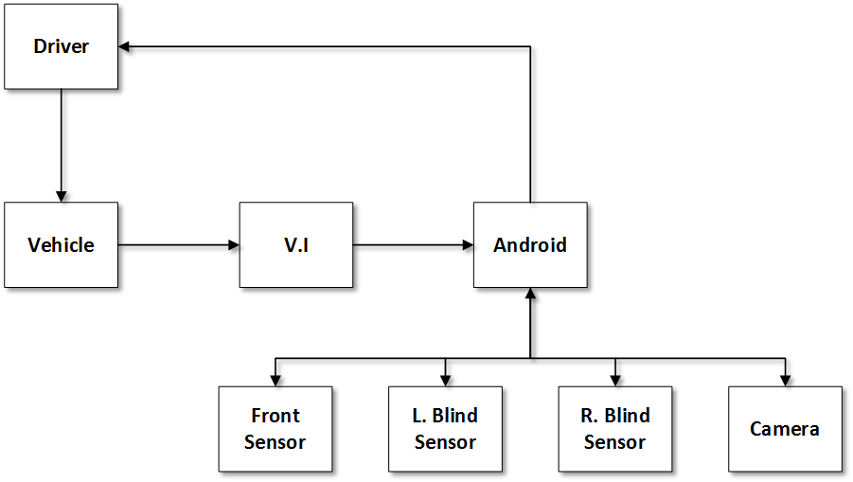
Project Overview

Slide 5
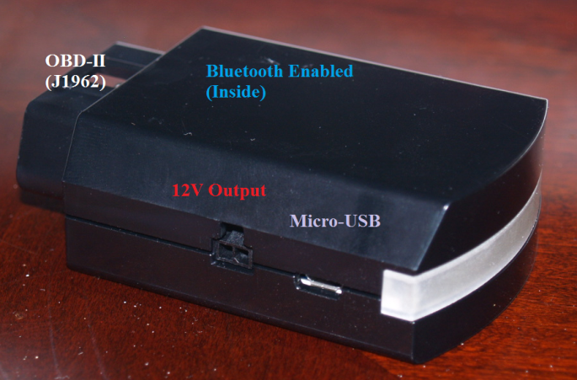
Vehicle Interface
OBD-II reader provided by Ford.
Access to specific information
  Brake pedal position
  Accelerator pedal position
  Gear lever position (Automatic Transmission)
Sends real time vehicle information to a PC or Android device.
Bluetooth enabled for wireless communication.
12V output to power nearby accessories.

Slide 6
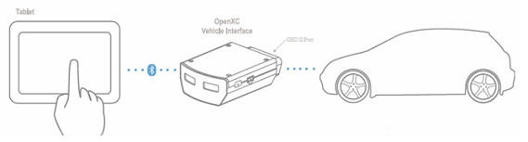
Ford OpenXC
A combination of open source hardware and software.
Allows for custom vehicle applications.
Can only be used with Android devices and Ford vehicles.

Slide 7
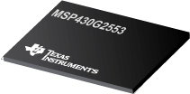
Microcontroller
Texas Instruments MSP430G2553
Ultra low power consumption
  Multiple low power modes
  Wake up from standby mode in less than 1µs.
Low price for development board.
UART pins for wireless communication.
Integrated ADC peripheral

Slide 8
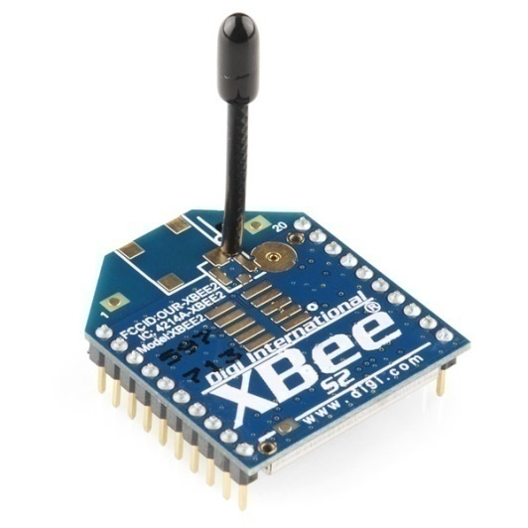

Wireless Communication
Limited by Android device and Vehicle Interface.
Zigbee
  Requires available USB connection to interact directly with an Android device.
Wi-Fi
  Requires the addition of a router in the vehicle.
Bluetooth
  Can only have 1 SPP UUID connected to the Android phone at a time. (Serial Port)

Slide 9
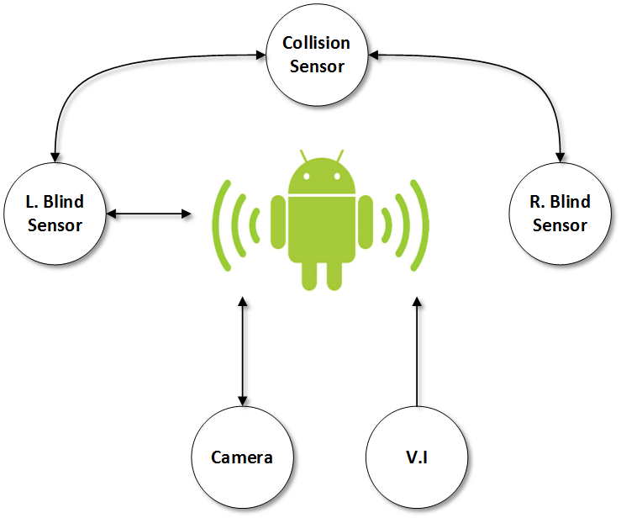
Wireless Communication
Decided to use Bluetooth for the blind spot sensors and collision sensor.
Can use low cost modules for simple data transmission.
Create a “custom” piconet by cascading communication. This allows the Android device to communicate with each hardware component.

Slide 10
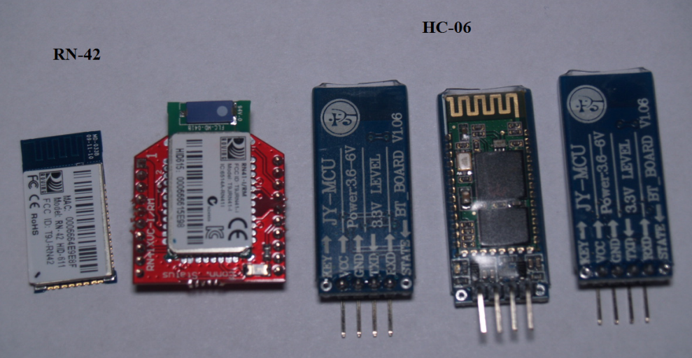
Wireless Communication
Master Device:
RN-42
  Responsible for communication between hardware peripherals.
Slave Device:
HC-06
  Responsible for communication between hardware peripherals and Android device.
  Also responsible for receiving instructions from master device.

Slide 11
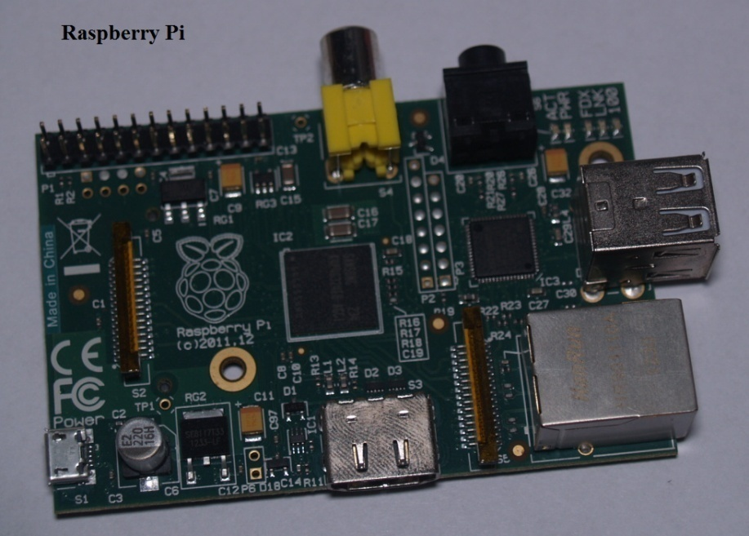
Wireless Communication
Bluetooth is not the best method for video streaming to an Android device.
A Raspberry Pi will be used with an attached wireless adapter USB to connect the camera and Android wirelessly.
May integrate sensors using the wireless communication provided by the Raspberry Pi.

Slide 12
Power Management
Car battery
  Requires wires to be ran across the vehicle.
  Consistent 12V source.
  Could drain the battery while vehicle is not in use.
Batteries
  Can be recharged by the driver.
  Does not require wires to be ran across the vehicle.
  Additional costs

Slide 13
Power Management
18650 8.4V 2200mAh Lithium-ion battery pack.
MCP7384 charge controller for the Lithium-ion battery.
Chose LDO regulators for simplicity and price.
  5V LDO regulator to power sensors and Op-amps.
  3.3V LDO regulator to power MCU and Bluetooth Modules.
Raspberry Pi will be powered through the cigarette lighter located at the front of the vehicle.
Android device being used can be charged using the micro-usb connection on the Vehicle Interface.

Slide 14
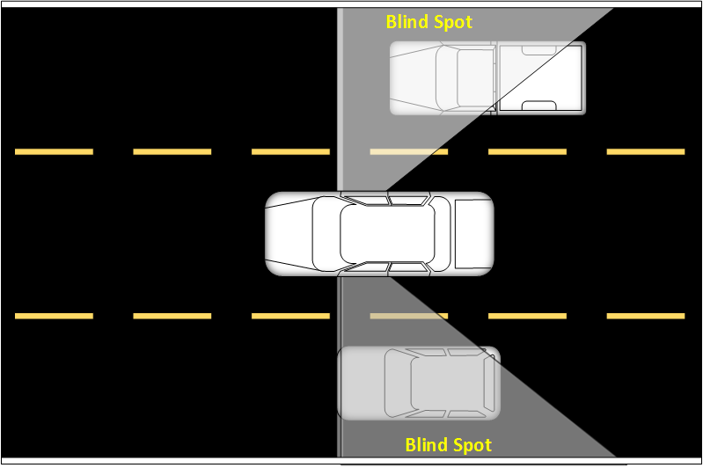
Lane Swap Assistance
Monitor area behind the vehicle while changing lanes.
Alerts driver when a vehicle is approaching from the rear.
Unfortunately Ford has not added a turn signal identifier within the OpenXC library.

Slide 15
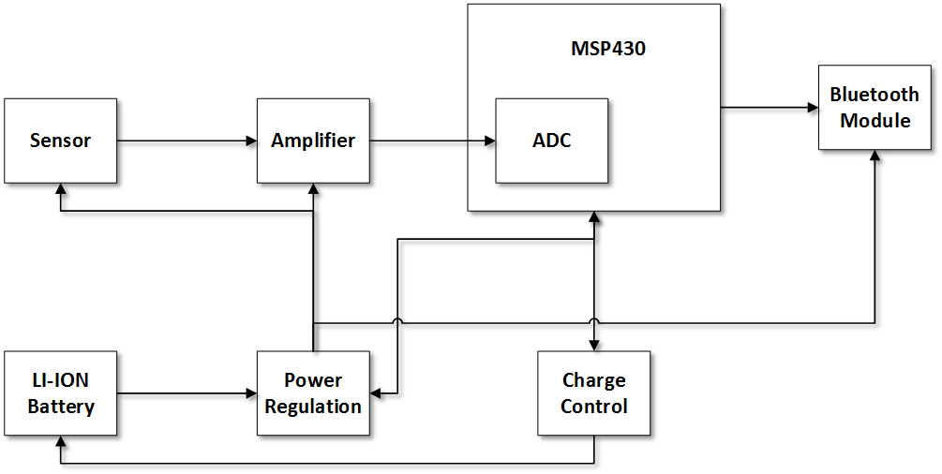
Lane Swap Assistance

Slide 16
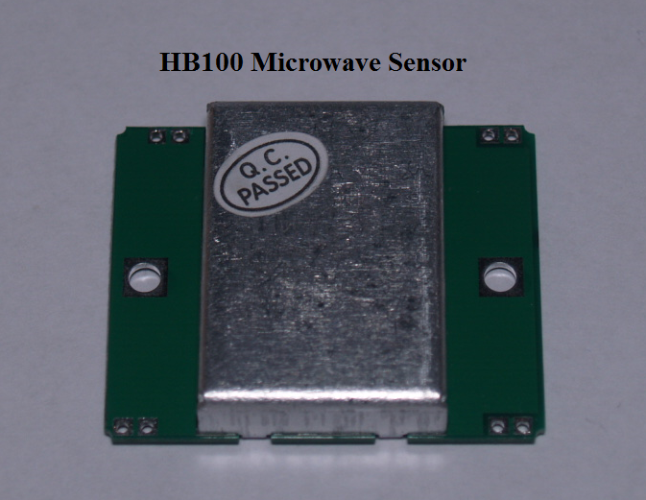
Lane Swap Assistance
Sensor:
HB100 microwave sensor
  5v Supply Voltage
  30mA supply current
  Max detection range of 15m
Microwaves can penetrate certain materials.
  Glass, plastic, and paper
Measures changes in frequency.
Analog output signal is in the range of microvolts (µV).
  Requires a large amplifying stage.

Slide 17
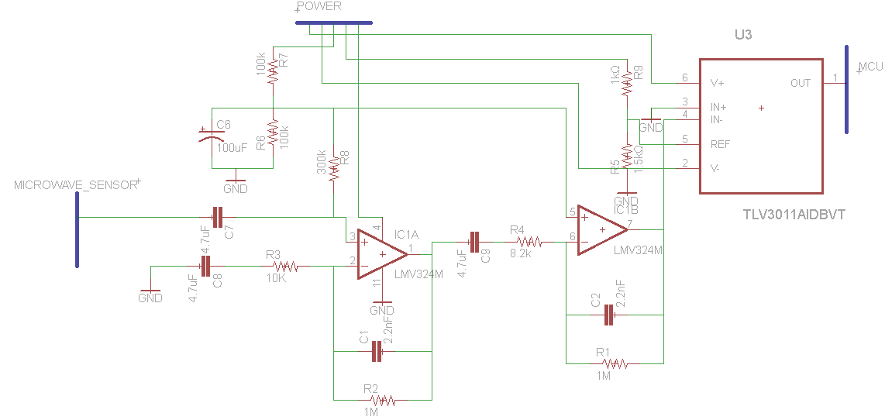
Lane Swap Assistance
Amplifying Stage:
Large gain of approximately 12000.
Comparator attached to provide an easy to read signal for MCU.
Summing Amplifier with a non-inverting op-amp attached for increased gain.

Slide 18
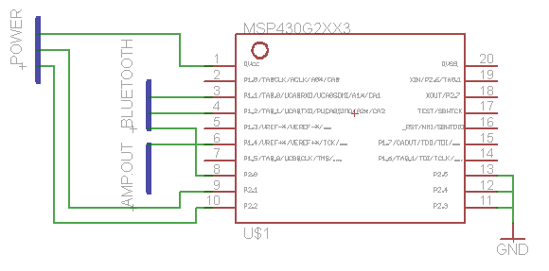
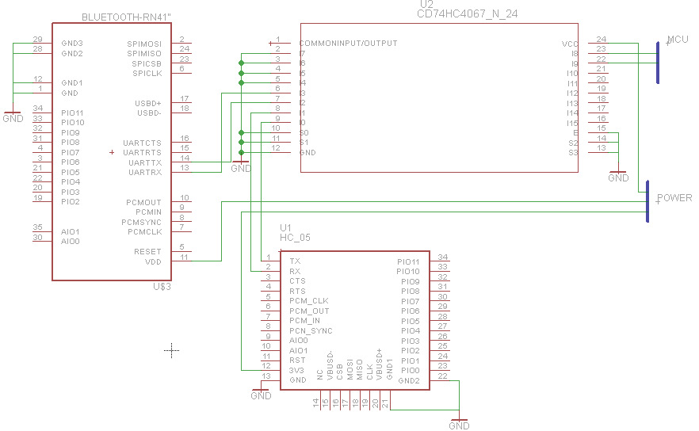
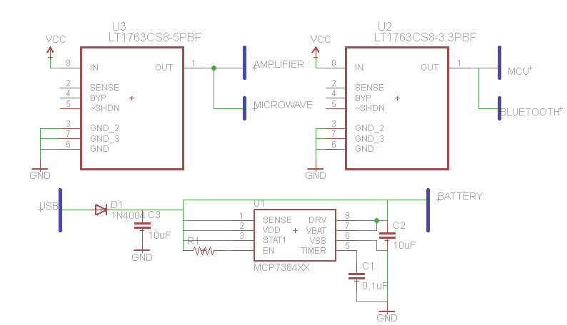
Lane Swap Assistance

Slide 19
Collision Detection
Monitor distance between drivers vehicle and vehicle directly towards the front.
Alert driver of potential collision based on vehicle speed and measured distance.
Activated while vehicle is being operated over 35mph to conserve battery life.

Slide 20
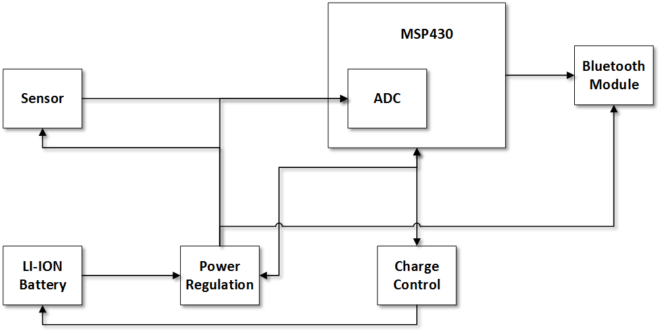
Collision Detection

Slide 21
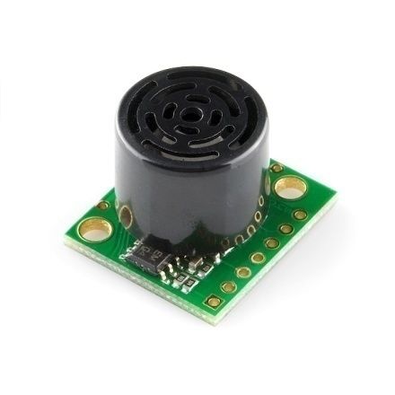
Collision Detection
Sensor:
Maxbotix LV-EZ1 Ultrasonic Sensor
  2.5V to 5.5V supply voltage
  Low 2ma supply current
  PWM and Analog outputs
  Max distance of 6.5m
Can be used to determine distance between the vehicle and an object towards the front.

Slide 22
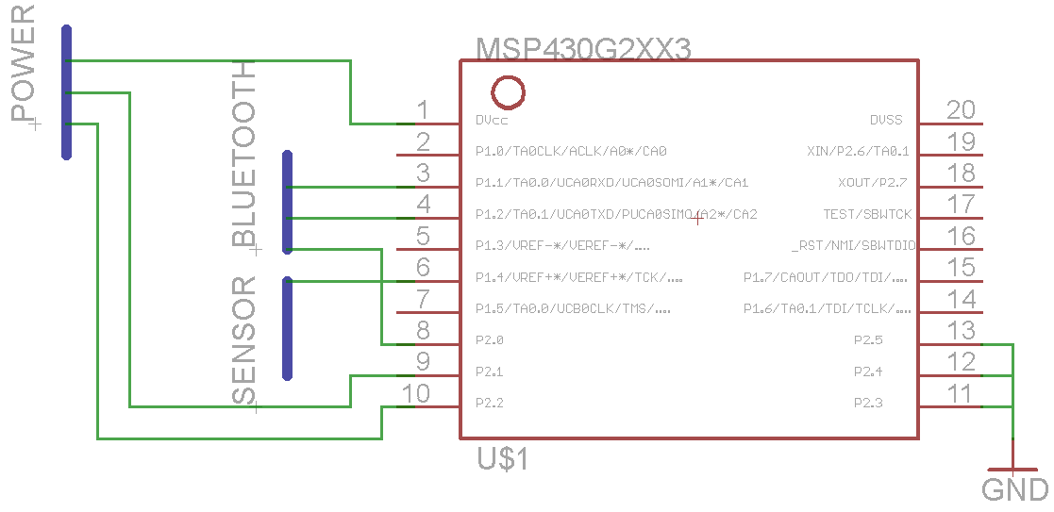
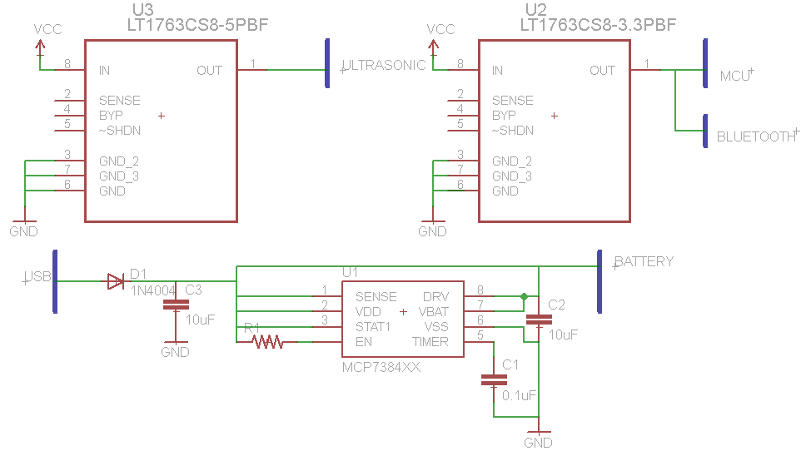
Collision Detection

Slide 23
Fuel Efficiency
Use OpenXC data to calculate fuel efficiency in real time
Display data to the user in real time in an easy to understand format
Store gathered data for the user to view later
Give advice for improving fuel efficiency
Allow the user to see improvements over time

Slide 24
Fuel Efficiency Calculations
The user’s score is calculated on a 0 to 100% scale
To calculate the score, the past 9 accelerations and the current acceleration are added together and a weighted average is applied, giving a higher weight to the most recent acceleration.
The accelerations are calculated using the current velocity and past velocity and divided by the time in between the velocities, which is 50ms
If the user is accelerating, the average acceleration is multiplied by a factor of 10 to produce the score out of 100
If the user is decelerating, the average acceleration is multiplied by a factor of 6.25 to produce the score out of 100
This is because using the brakes has a greater affect on acceleration, so the affect on the score needed to be decreased

Slide 25
Fuel Efficiency Calculations
Suggestions on how to improve fuel efficiency are presented to the driver while the vehicle is not moving.
These suggestions are based on the user’s driving behaviors.
The factor with the highest score while idle is shown and then reset to zero once the vehicle is in motion, allowing for other suggestions to show up when the vehicle is idle again.
The factors are also stored for long term analysis and not reset to zero.

Slide 26
Fuel Efficiency Calculations
The user receives :
1 point for accelerating hard every 30 seconds
  Overall score is under 50% and the accelerator is pressed
1 point for braking hard every 30 seconds
  Overall score is under 50% and the brake pedal is pressed
1 point for accelerating and then braking within 10 seconds
  Counts if the accelerator was pressed over 20%
1 point for driving over 70 mph every 30 seconds
1 point for idling over 1 minute
  User automatically receives a message about idling for more than 1 minute, even if another factor has a higher score

Slide 27
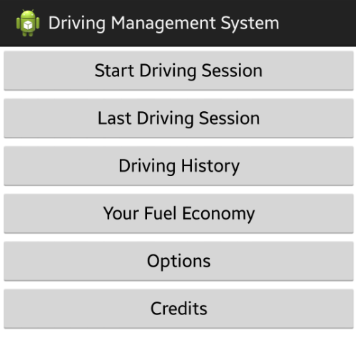
Application
←User presses this button before driving.
  It displays a solid color depending on the user’s real time driving habits. If the sensors detect motion under the right conditions, it plays a noise and shows an image as a warning.

Slide 28
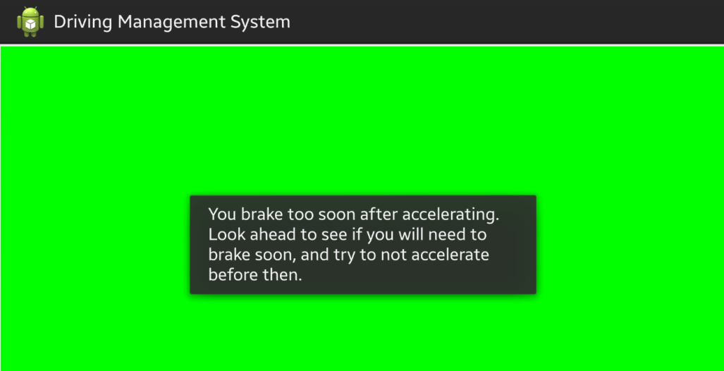
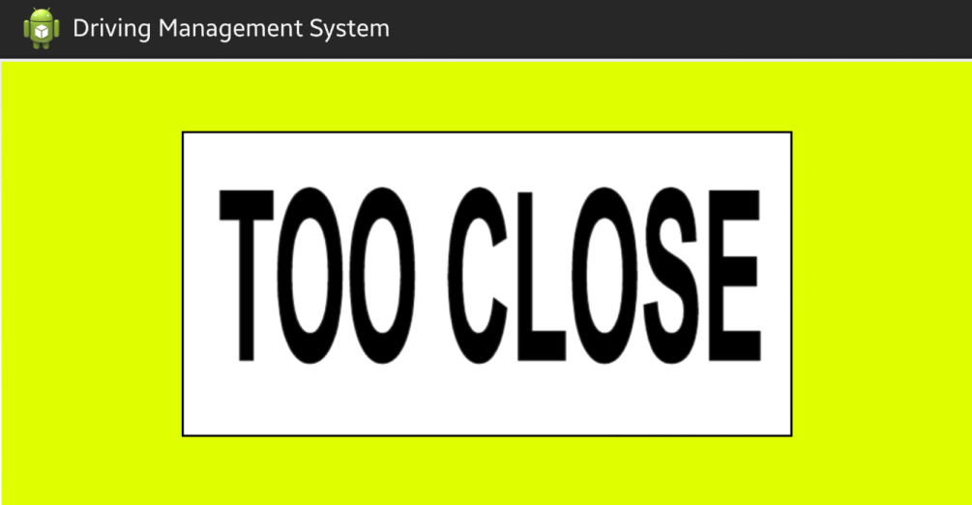
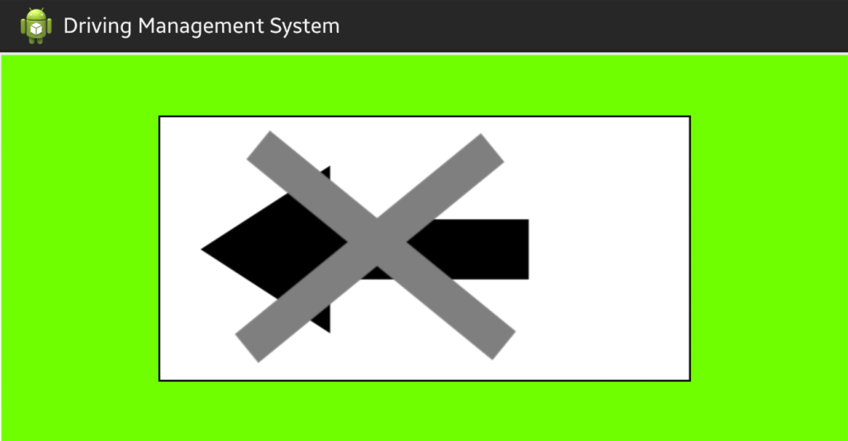
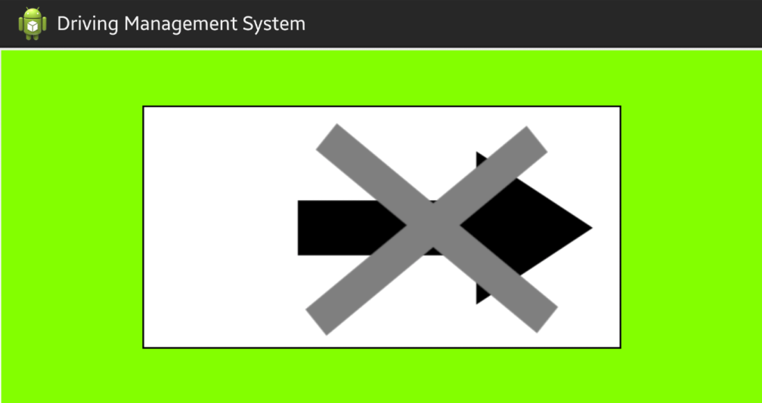
Application

Slide 29
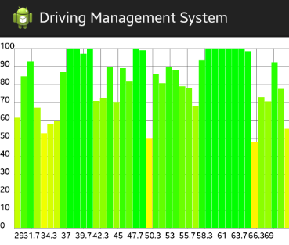
Application
←User presses this button to view the chart
  of their most recent driving session.

Slide 30
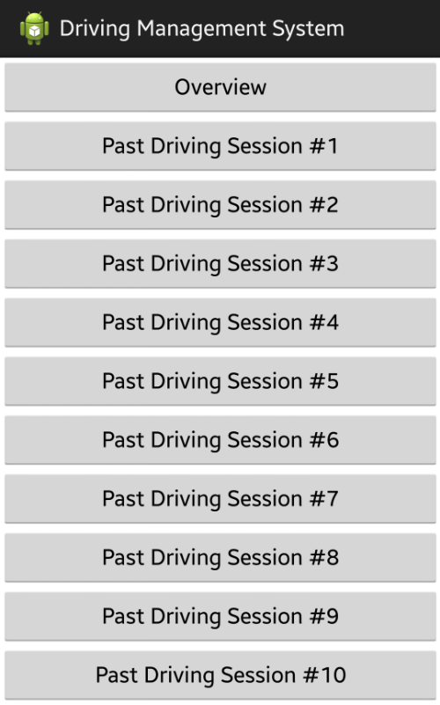
Application
→

Slide 31
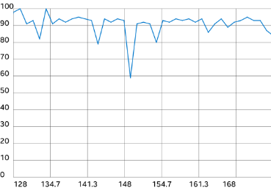
Application
→
Displays a graph showing one data point per driving session, allowing the user to see how they have improved over time.
Stores data for all driving sessions, not just the most recent ones.

Slide 32
Application
Most recent driving session
→
Oldest stored driving session
→

Slide 33
Application
←User presses this button to view an overview
  of their fuel economy and suggestions for improving their fuel economy.

Slide 34
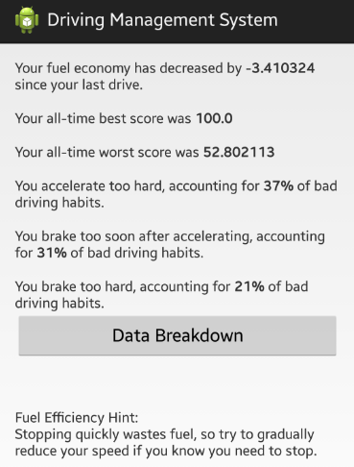
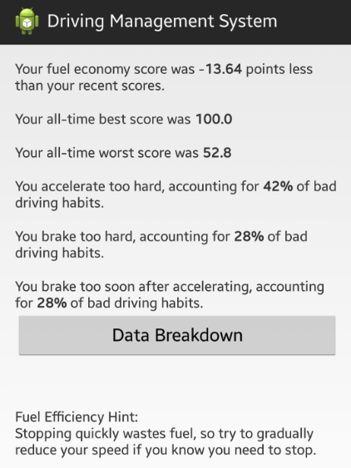
Application
←This shows how much the fuel economy score
  has increased or decreased compared to the average of the past 9 drives to let the driver know if they are improving at a glance.

Slide 35
Application
←The best and worst overall scores are shown
  here.

Slide 36
Application
←The top 3 bad driving habits are displayed for
  the user to easily see. The percentage shows how much they are doing that behavior in comparison to other behaviors.

Slide 37
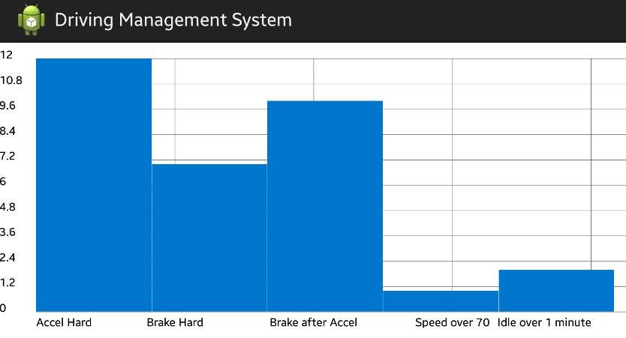
Application
←User presses this button to see the scores for
  all 5 driving habits.

Slide 38
Application
←A random fuel efficiency hint is shown here.
There are 7 possible hints that can be shown.

Slide 39
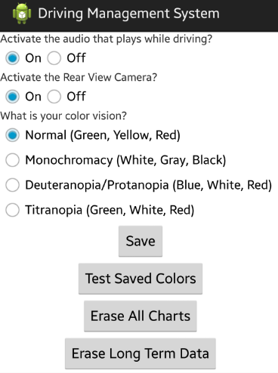
Application
→

Slide 40
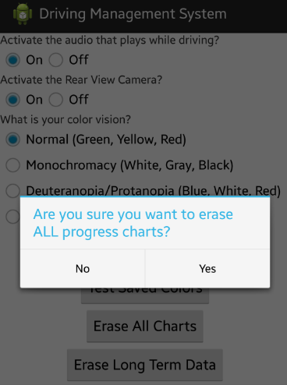
Application
→

Slide 41
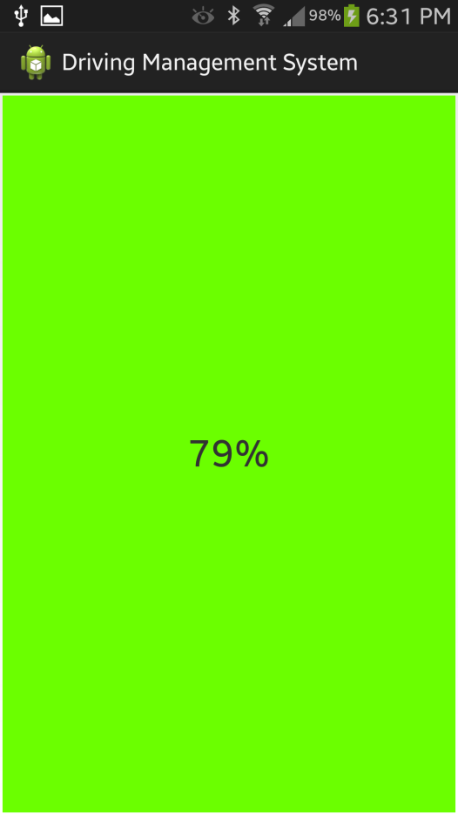
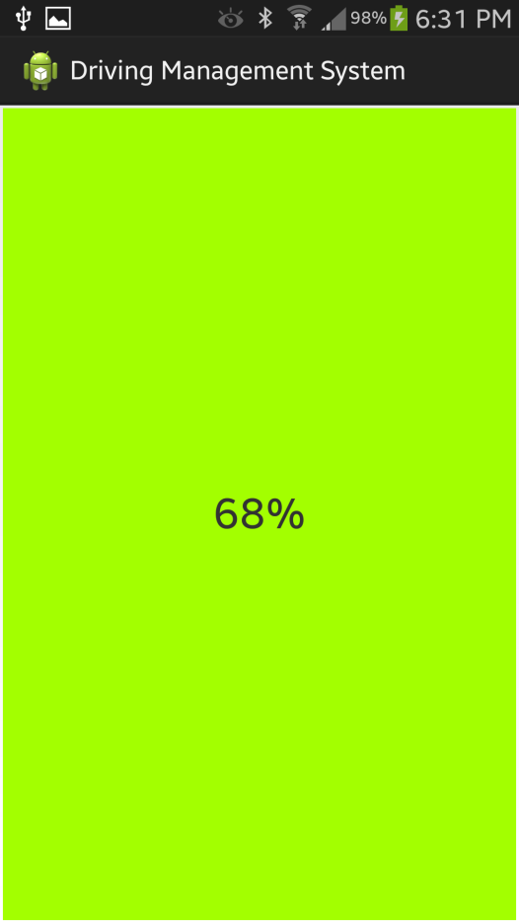
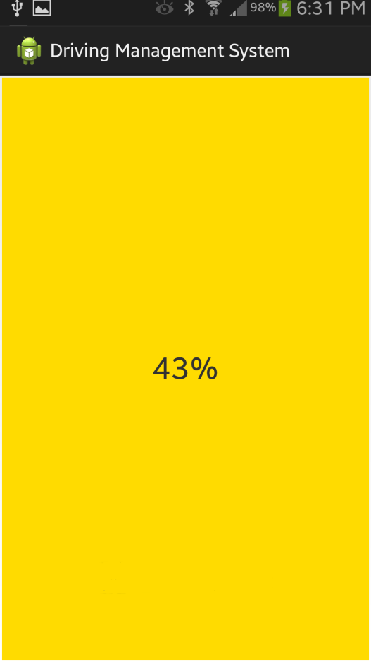
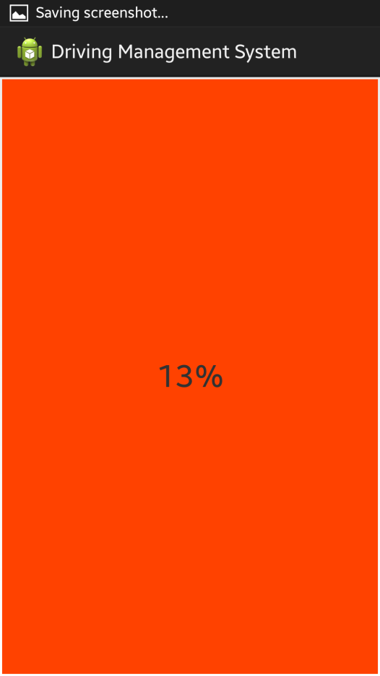
Application

Slide 42
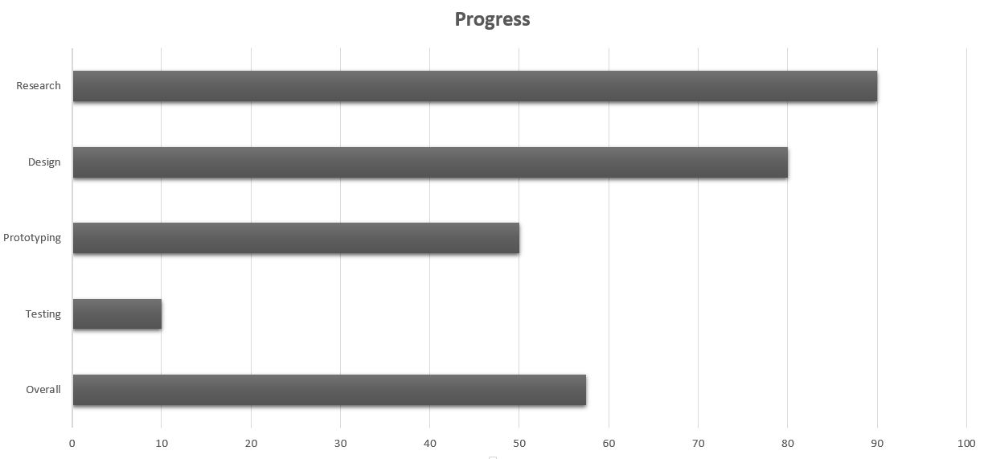
Project to Date

Slide 43
Work Distribution
 | Wireless Comm. | Power | Hardware | Camera | Android App
Aaron Kost | X |  | X | X | X
Sarah Bokunic | X |  |  | X | X
Victor Medina | X | X | X | X

Slide 44
Budget
What? | Where? | Qty. | Price
Op-Amps/IC’s/Regulators | (Samples) | Vary. | $0.00
HB100 Microwave Sensor | ST Electronics | 2 | $20.00
Maxbotix Ultrasonic Sensor | Parallax | 1 | $25.95
RN-42 Bluetooth Module | Roving Networks | 1 | $15.95
HC-06 Bluetooth Module | EXP-tech | 2 | $17.98
USB Webcam | PlayStation | 1 | $19.99
Lithium Ion Battery |  | 3 | $30.00
Plastic Encasing | Polycase | 3 | $9.00
PCB | OSH Park | 3 | $70.00 (estimated)
(Estimated) Total |  |  | $210.00

Slide 45
Problems/Issues
Multiple wireless connections to an Android device.
Noisy analog output from microwave sensor.
No turn signal available in OpenXC library.
Android device battery life with multiple Bluetooth connections.

Slide 46
Questions?

